Slide 1
VE Map
Showing Ship Position from AIS

Slide 2
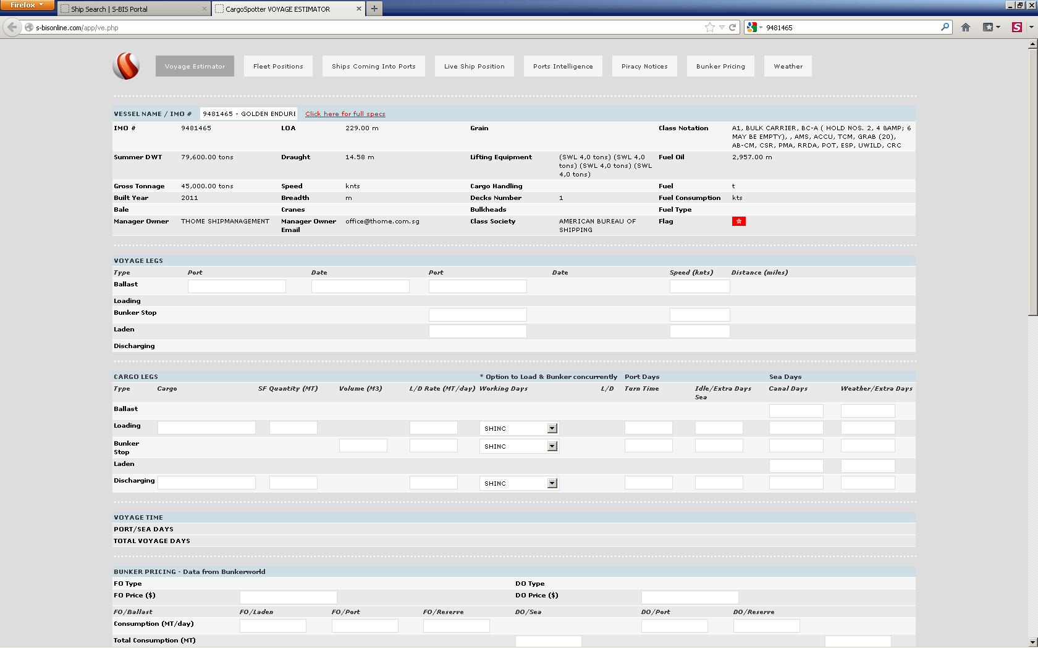
Name: GOLDEN ENDURER IMO: 9481465

Slide 3
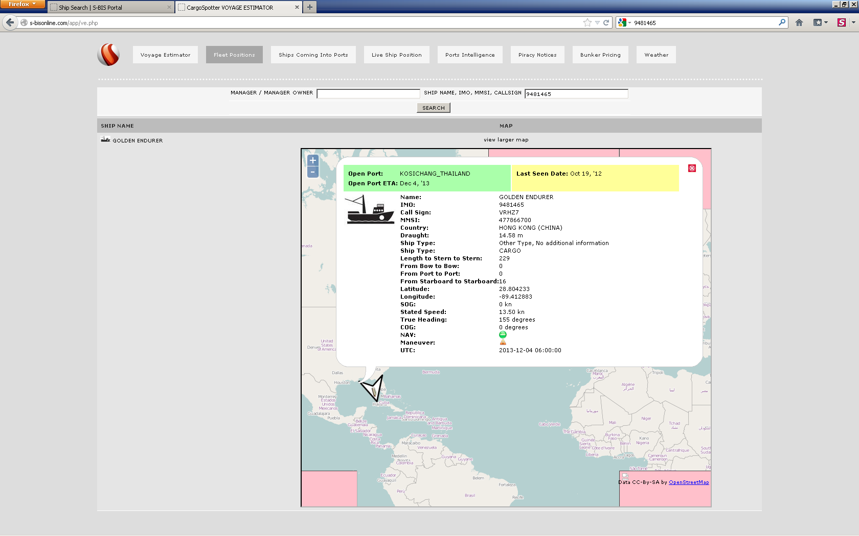
Use this Map code for MAP in VE-showing where ship is

Slide 4
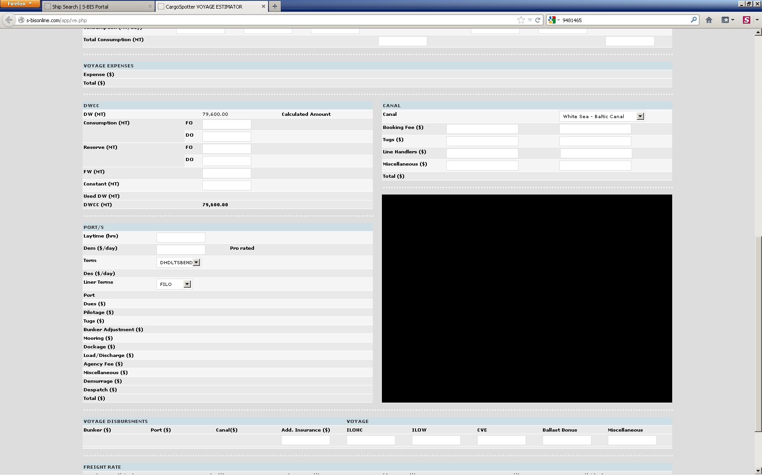

The MAP should be the same one showing where the ship is now – Slide 3

Slide 5
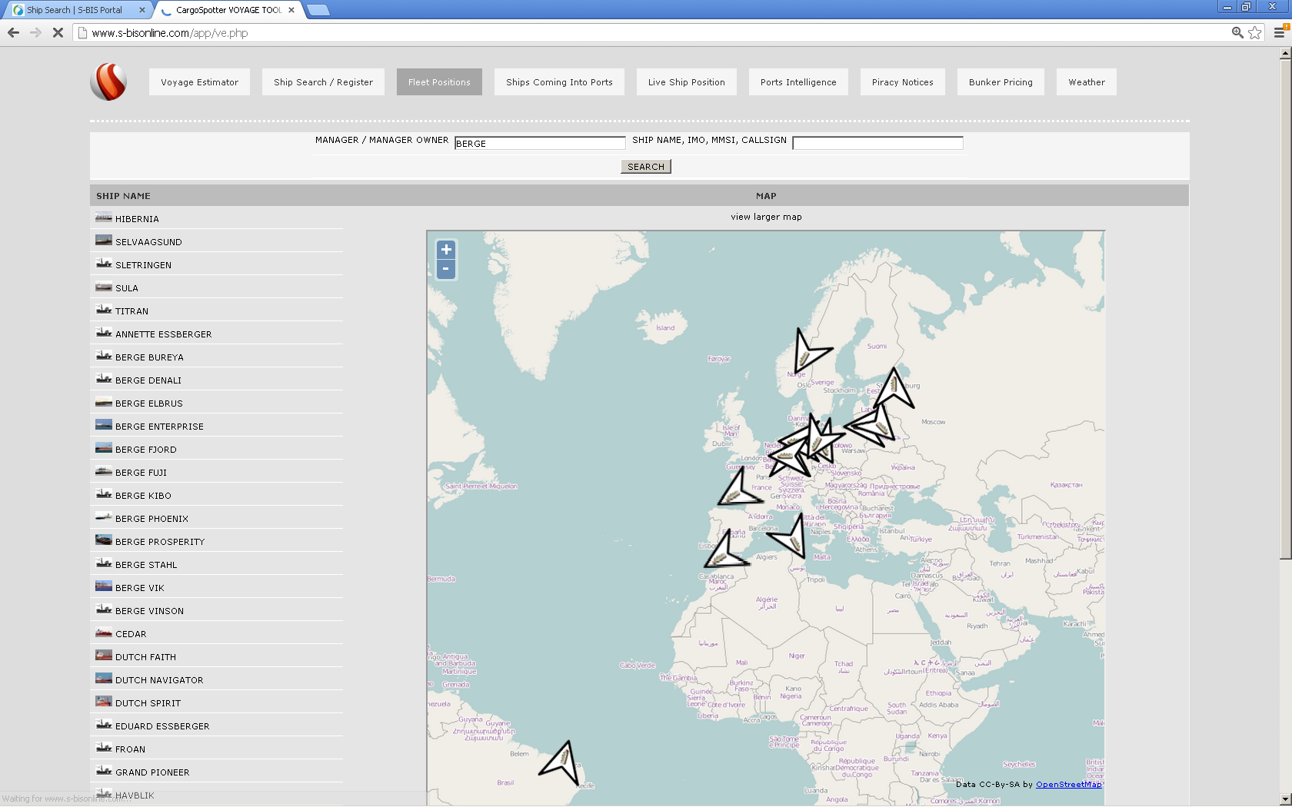
View Position Add link so you can see the individual ships
View Position
View Position
View Position
View Position
View Position
View Position
View Position
View Position
View Position
View Position
View Position
View Position
View Position
View Position

